Slide 1

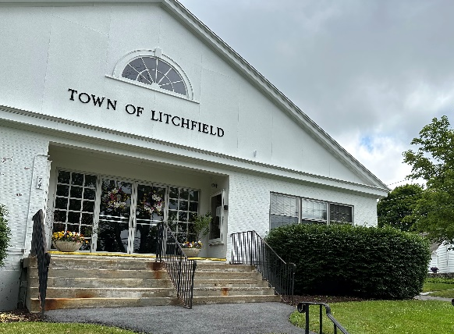
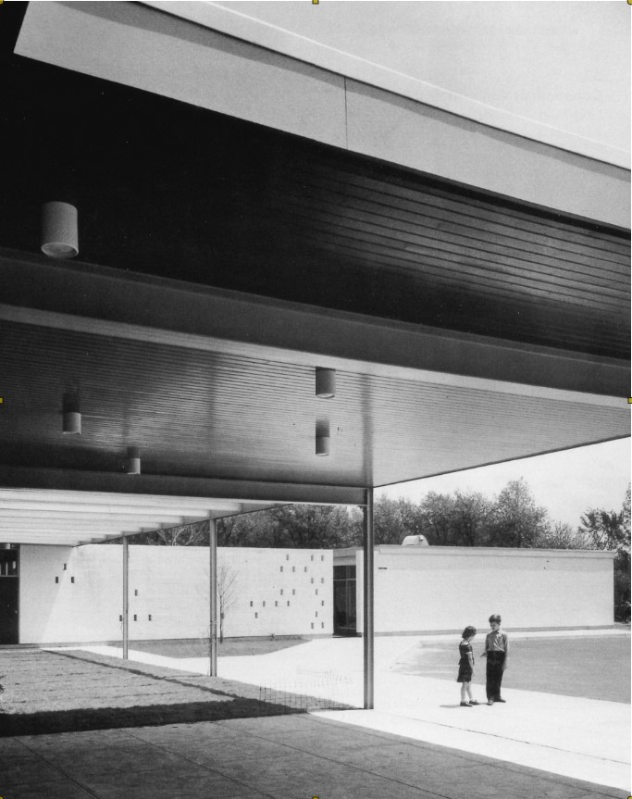

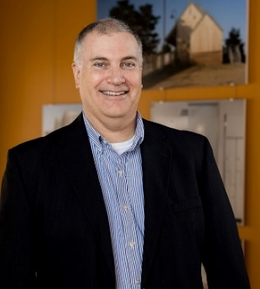

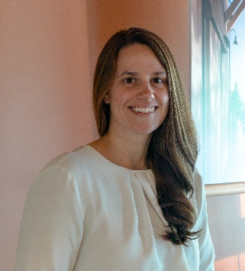

LITCHFIELD, CT
TOWN MEETING #5
September 29, 2026
Michael P. Fortuna, AIA
Principal
Paula Tunney, AIA
Associate
Alicia Rosalie, AIA
Architect
Luis Molina
Emerging Professional
INTRODUCTION

Slide 2

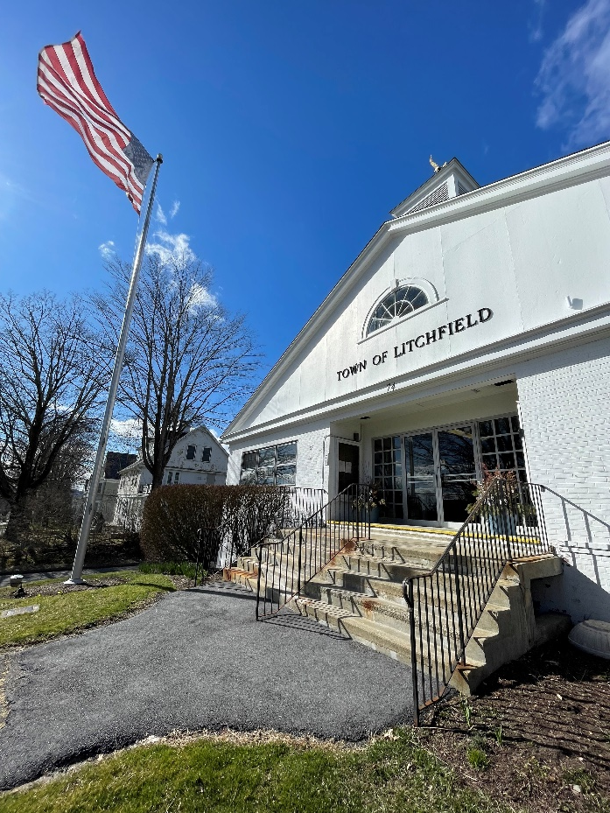
Town Facilities Review Committee
The mission of the Town Facilities Review Committee shall be to review and evaluate future town facility needs and to recommend the most efficient use of the current Town Hall and Bantam School (Town Hall Annex).
Members:
Barbara Putnam, Chairman
Chris Casiello, Vice-Chairman
Sam Olmstead
Carol Powers
Burke Gibney
Diane Field
Jeff Zullo, BOS Member
Mike Eucalito
Denise Raap, First Selectperson
INTRODUCTION

Slide 3
2012: Town Hall Building Committee develops plan for new Town Hall behind existing Town Hall at 74 West Street.
2013: New Litchfield Town Hall proposal rejected at referendum.
2017: The former Litchfield County Courthouse closed, and the Greater Litchfield Preservation Trust develops plans to use it as Town Hall, with an addition on the back of the structure. 80 Doyle Road would be given to Litchfield Housing Trust for affordable housing.
2018: Proposal rejected at referendum.
2020: Town Facilities Review Committee formed to assess underutilized Town-owned property.
2021 (Spring): A survey was distributed to 4,517 residential mailing addresses in Litchfield, with 958 responses received.
2021: Bantam citizens’ group worked with an Architect to conceptualize future uses of the Town Hall Annex.
2024: TLBA retained to study best use of Town Buildings:
  Conditions assessment of Town Hall and Bantam Annex
  Programming analysis of all town departments
  Options and recommendations for rehabilitation and reuse of Bantam Annex
PROCESS BACKGROUND

Slide 4
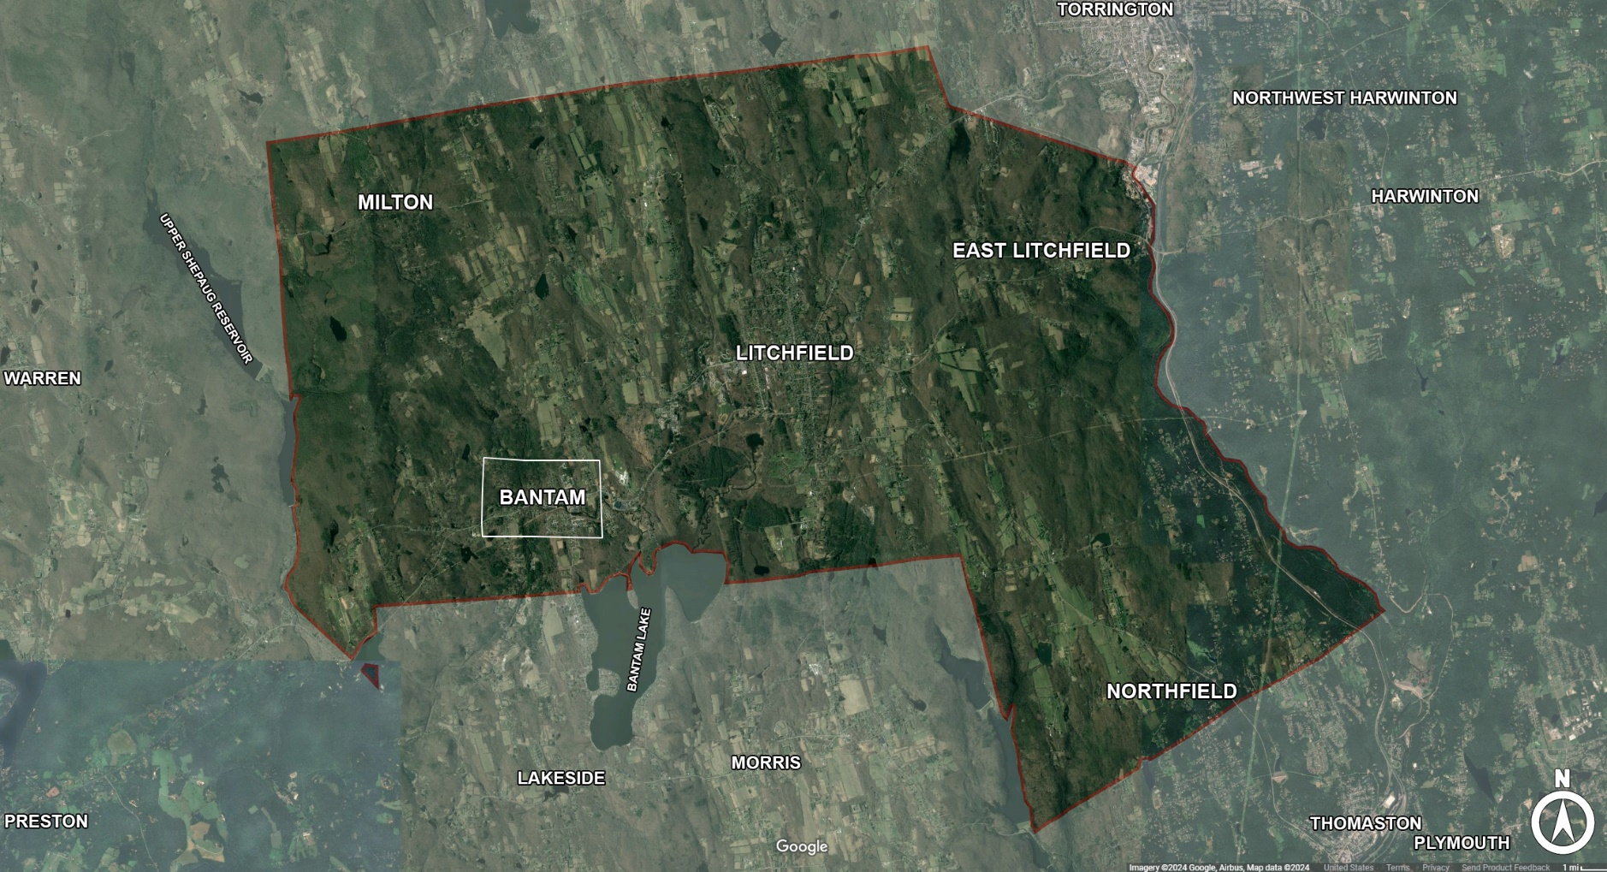
Boroughs
Litchfield
Bantam
Villages
E. Litchfield
Northfield
Milton
CONTEXT

Slide 5



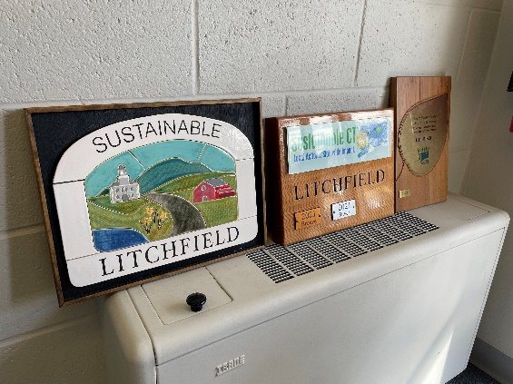
Implement sustainable strategies, such as eliminating use of fossil fuels, energy reduction, or producing on-site renewable energy.
Restore and preserve some of Litchfield’s architectural history.
SustainableCT.org
Inclusive and Equitable Communities
Thriving Local Economies
Well Stewarded Land and Natural Resources
Vibrant and Creative Cultural Ecosystems
Dynamic and Resilient Planning
Clean and Diverse Transportation Systems and Choices
Renewable and Efficient Energy
Inclusive Engagement, Communication and Education
Strategic Materials Management
Optimal Health and Wellness Opportunities
Healthy, Efficient, and Diverse Housing
Effective, Compassionate Homelessness Prevention
Innovative Strategies and Practices
OPPORTUNITIES

Slide 6
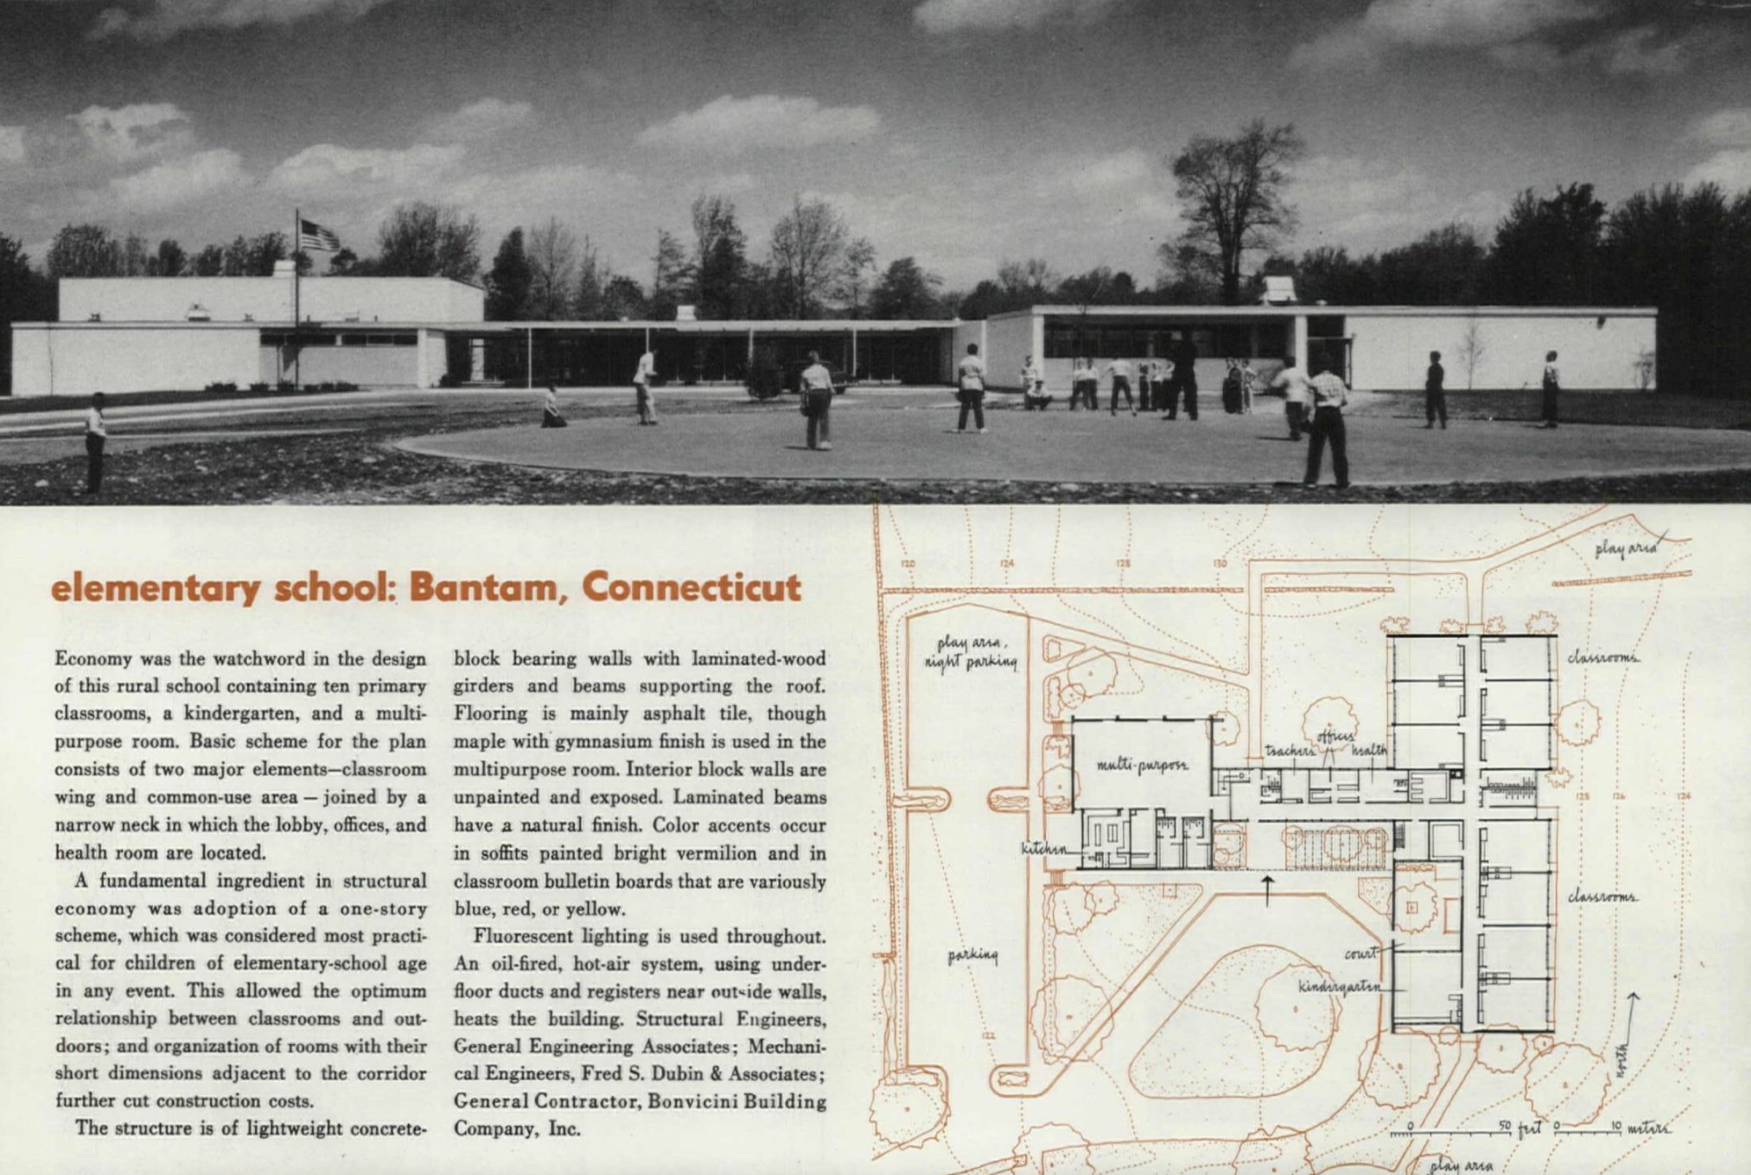
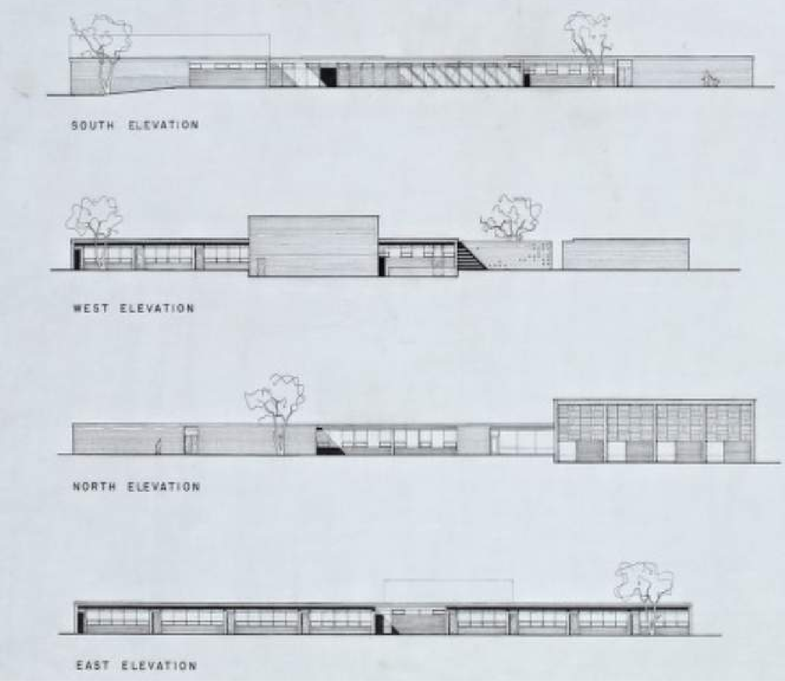
History
1954: Constructed as the Bantam Elementary School, designed by Marcel Breuer.
1991: Renovated for the Superior Court.
2017: Litchfield Judicial District Courthouse (new construction) opens in Torrington.
2023: Post Office lease extended, generating $63,000/year in revenue.
BUILDING HISTORY - BANTAM ANNEX

Slide 7
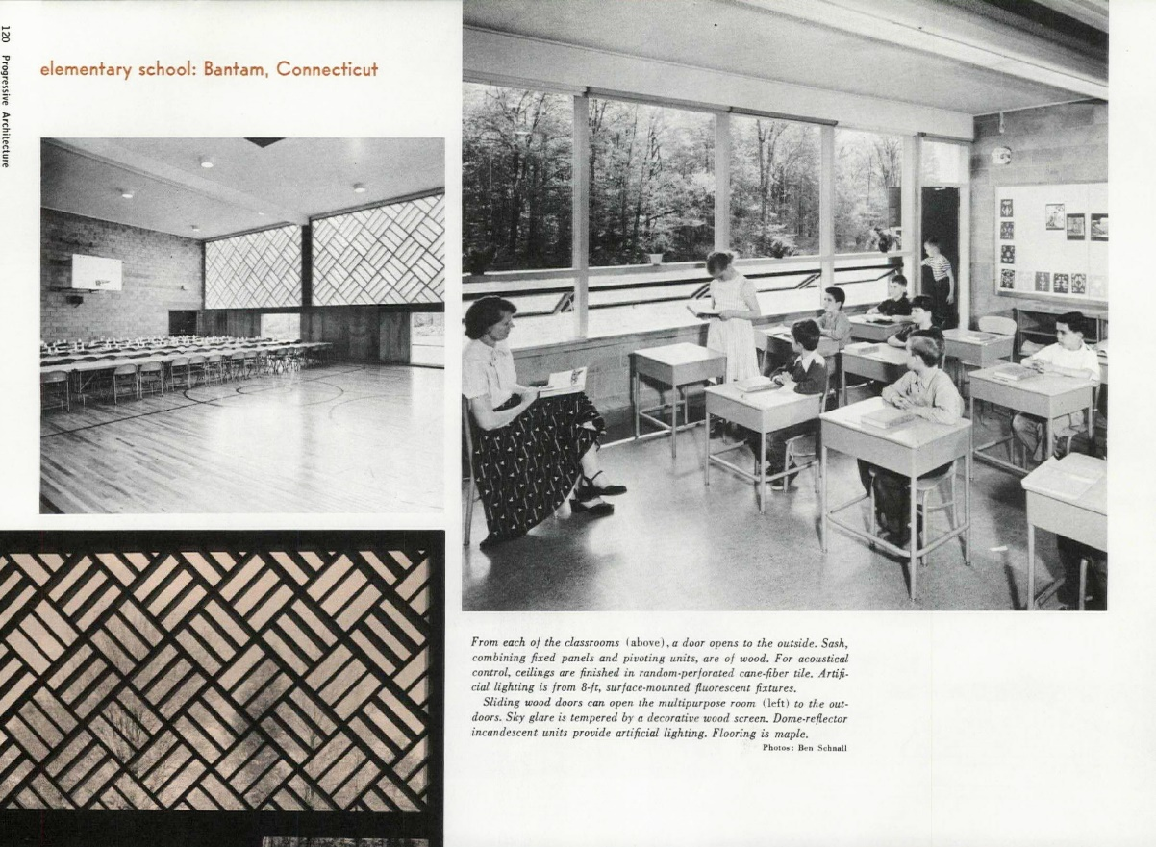
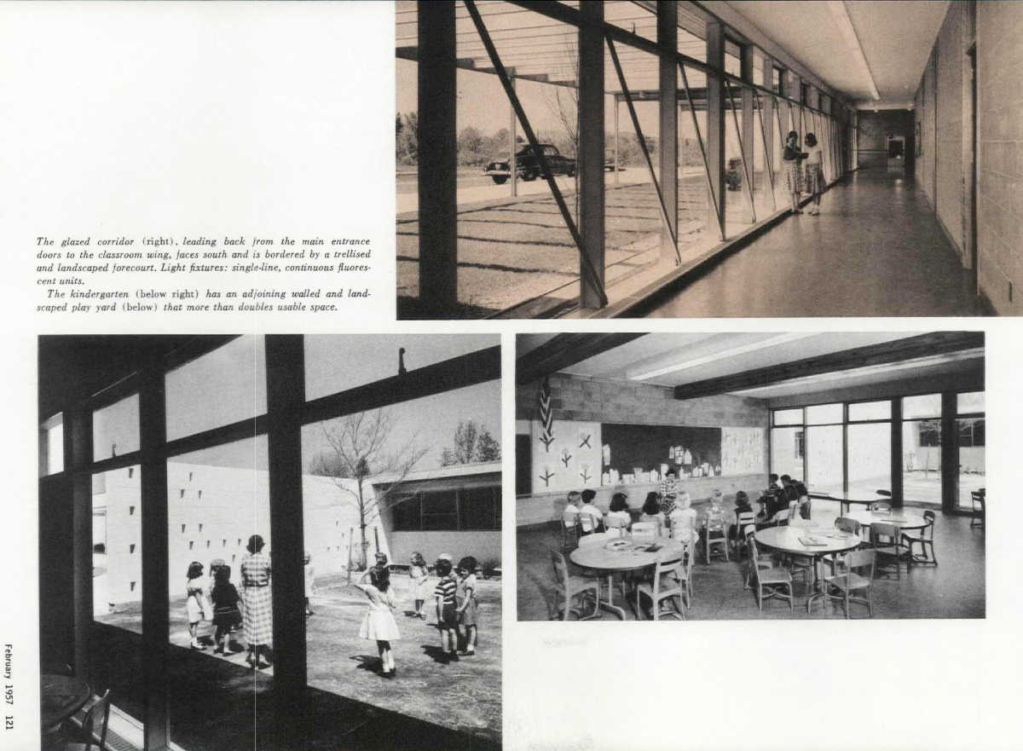
BUILDING HISTORY - BANTAM ANNEX – PROGRESSIVE ARCHITECTURE

Slide 8
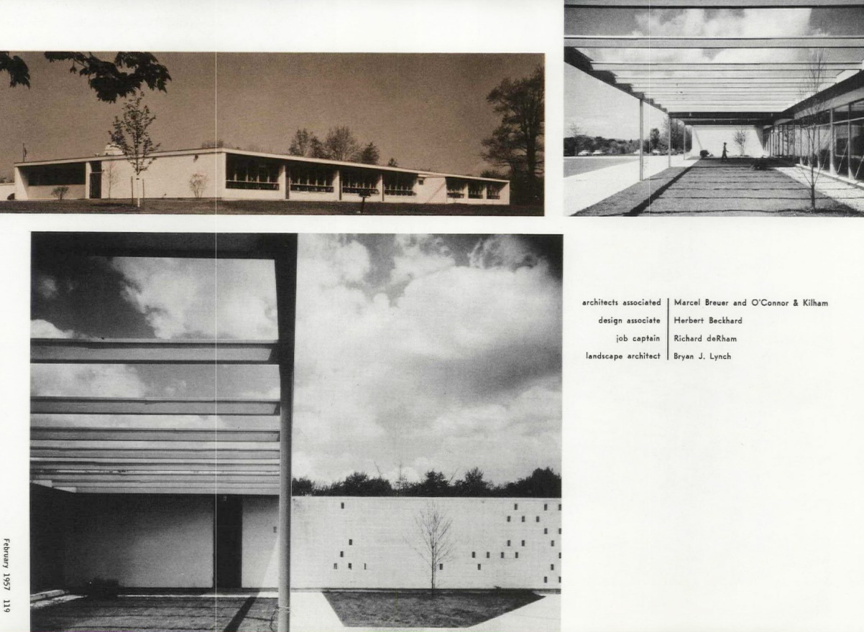
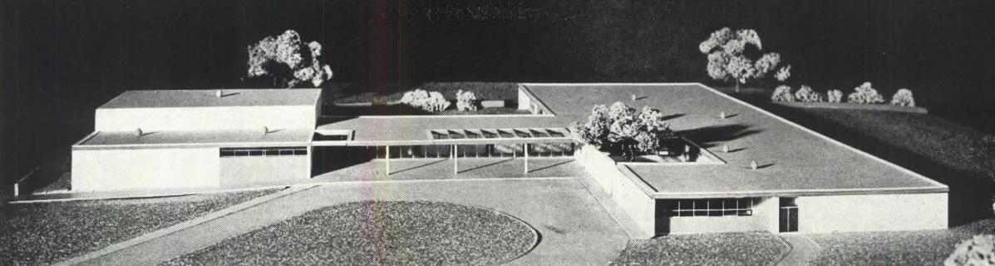
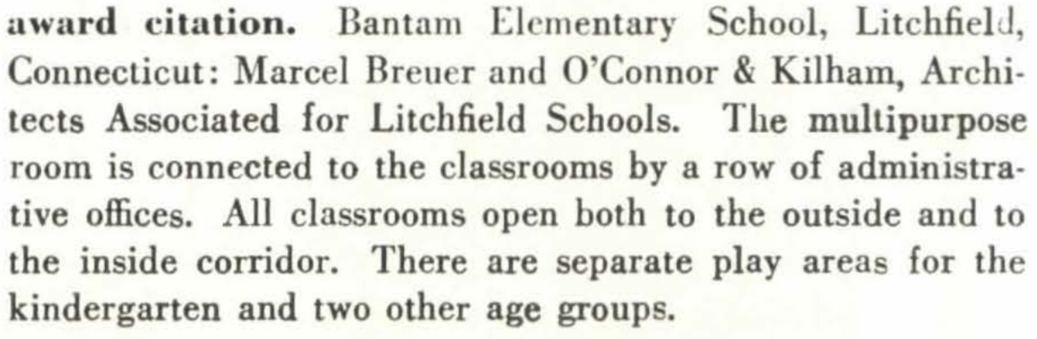
The Bantam Elementary School was featured in the magazine, Progressive Architecture, in January 1954 and February 1957.
The school received an award citation in 1954 in the “Design for Education” category of the magazine.
Basis of Design was Daylight, Efficiency and Cost Control
BUILDING HISTORY - BANTAM ANNEX – PROGRESSIVE ARCHITECTURE

Slide 9
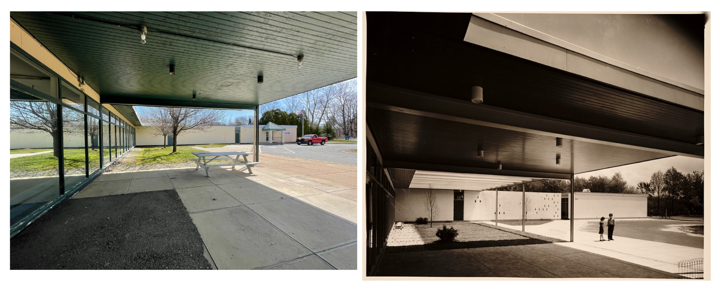
BUILDING HISTORY - BANTAM ANNEX

Slide 10
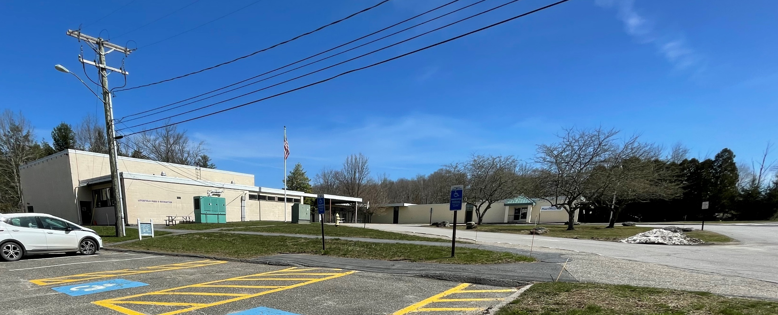
CONDITIONS ASSESSMENT – BANTAM ANNEX

Slide 11
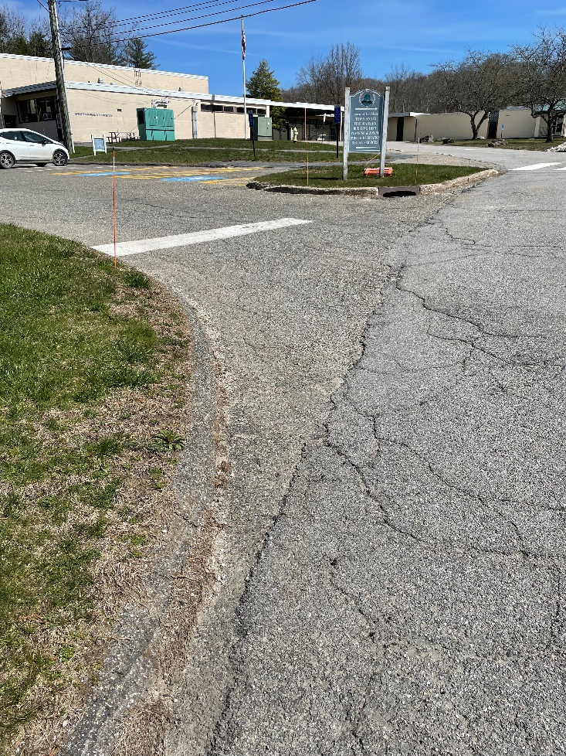
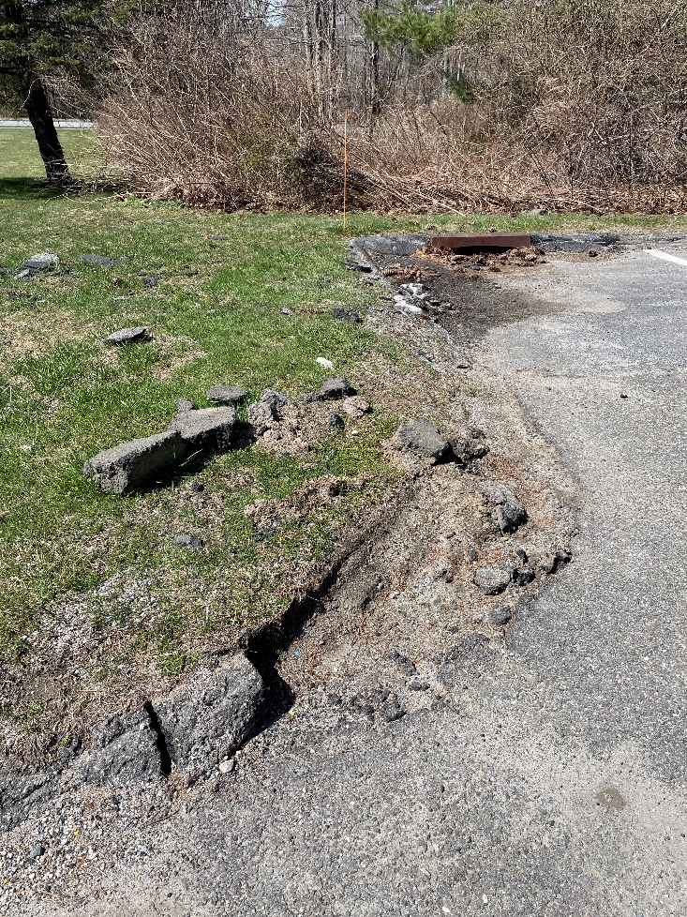
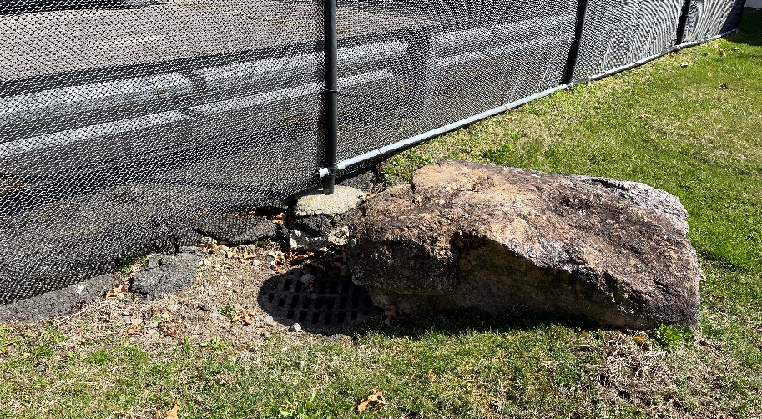
Site:
Parking is disproportionate to the current use, and site paving & curbs are generally in poor condition.
CONDITIONS ASSESSMENT - BANTAM ANNEX

Slide 12
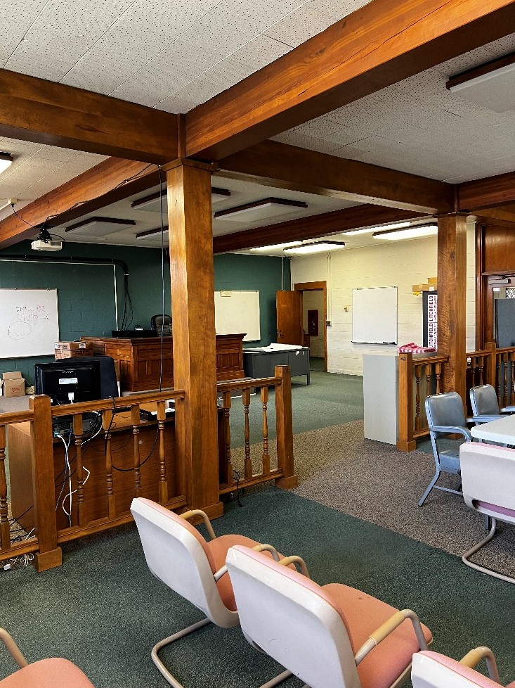
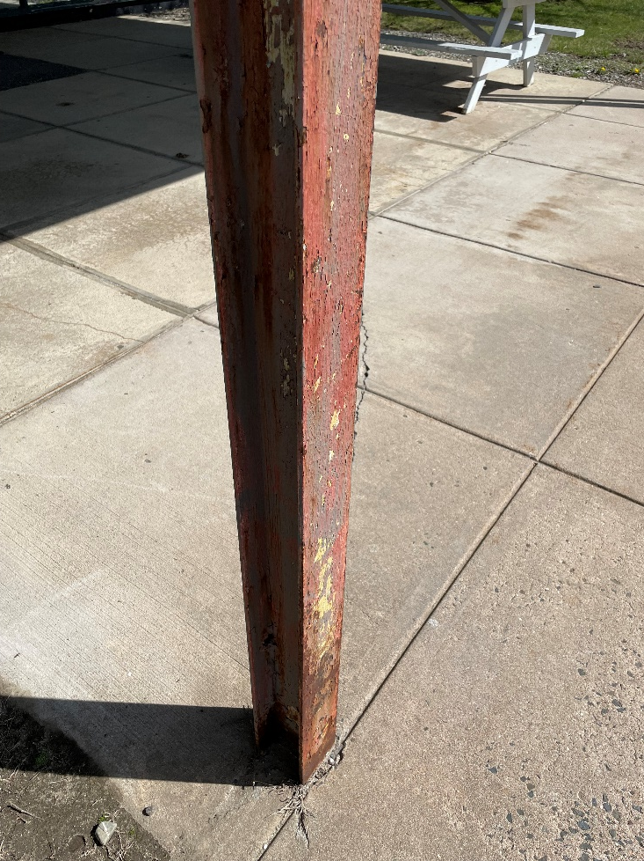
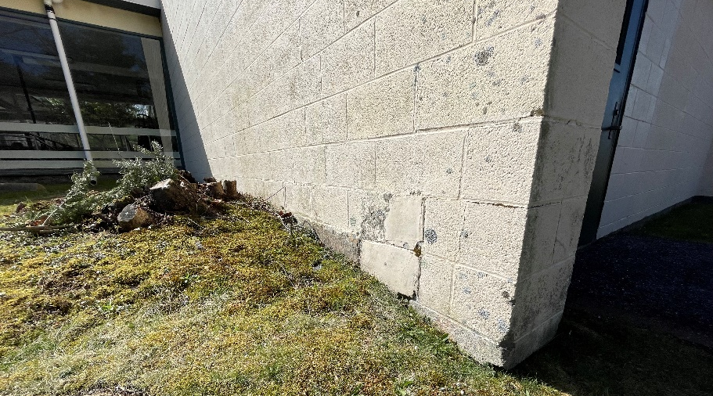
Structure:
Laminated wood beams over loadbearing concrete masonry units (CMU).
The structural steel used for the main entry canopy is sound, but the paint finish is in poor condition.
Portions of the exterior CMU, primarily at outside corners, are damaged or cracking.
CONDITIONS ASSESSMENT - BANTAM ANNEX

Slide 13
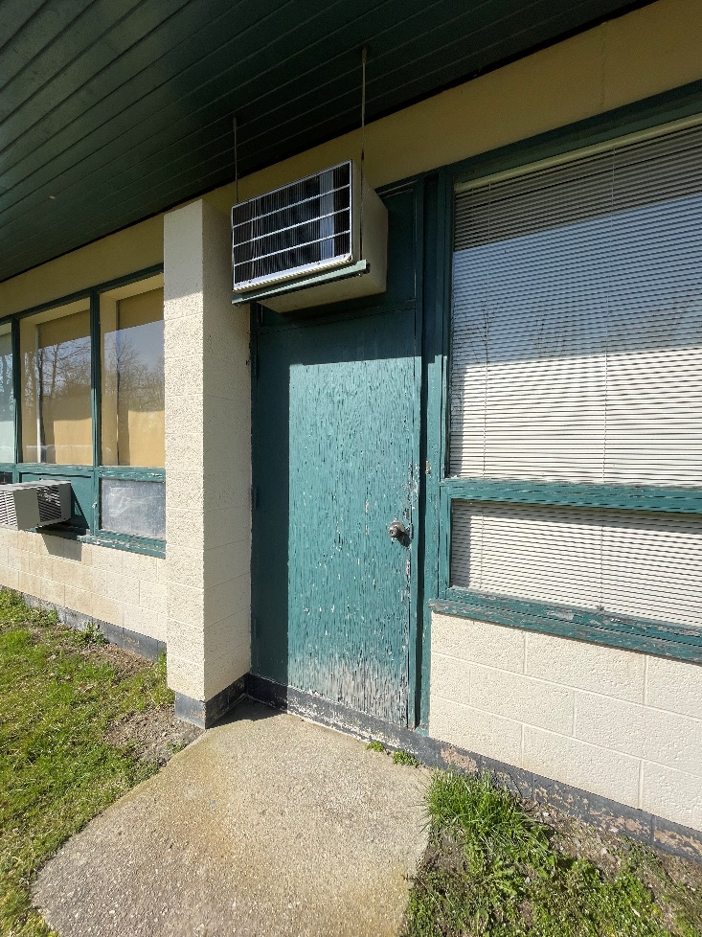
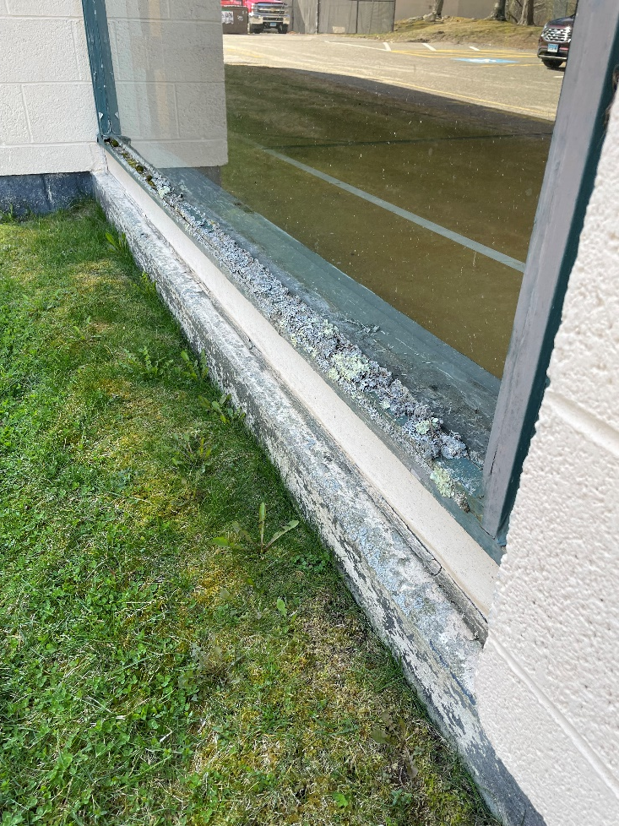
Building Exterior:
Walls:
  Painted CMU.
Windows:
  Wood-framed window systems have rotted in several locations, most commonly along the sills.
  The single-pane glazing is inefficient.
  Exterior wood doors & frames have rotted in some locations, and the paint finishes are generally in poor condition.
CONDITIONS ASSESSMENT - BANTAM ANNEX

Slide 14
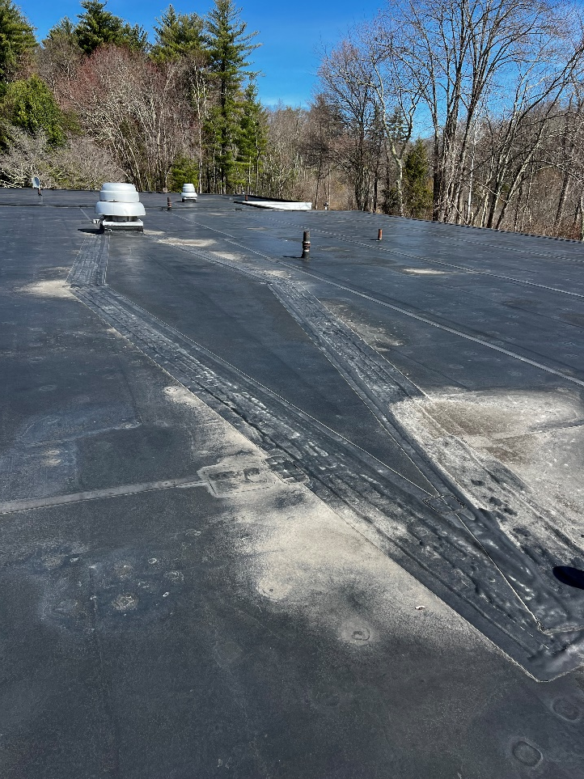
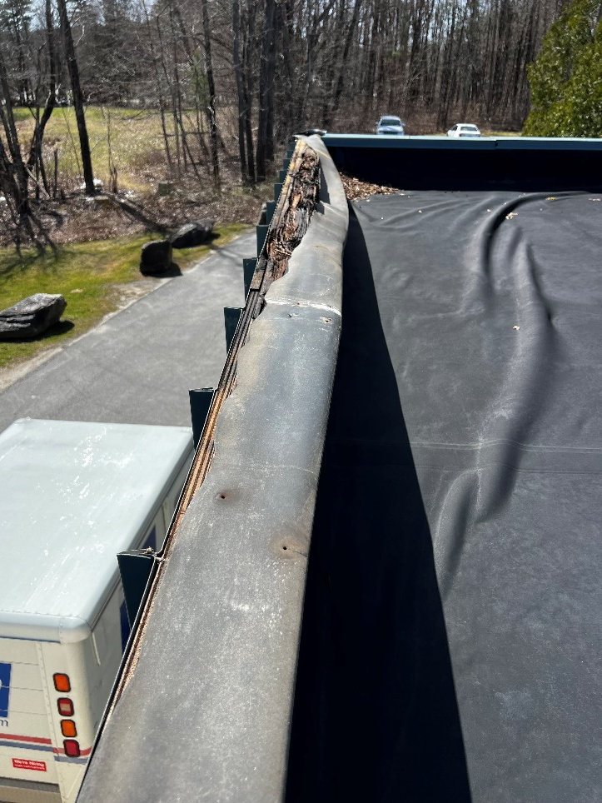

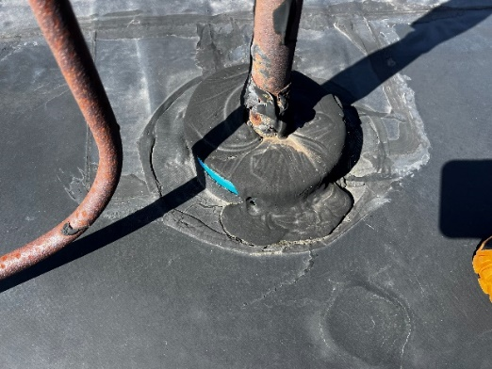
Building Exterior:
Roof:
  The single-ply EPDM roof is beyond its useful life.
  Flashings are also generally in poor condition.
BANTAM ANNEX - ROOF

Slide 15
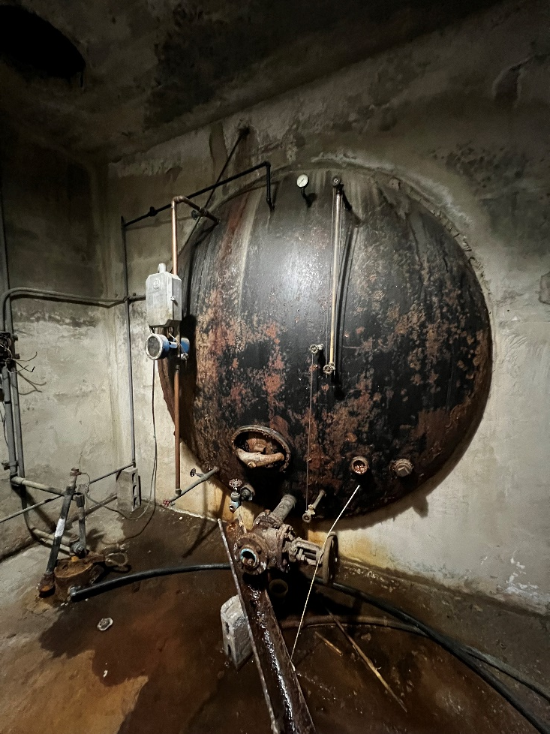
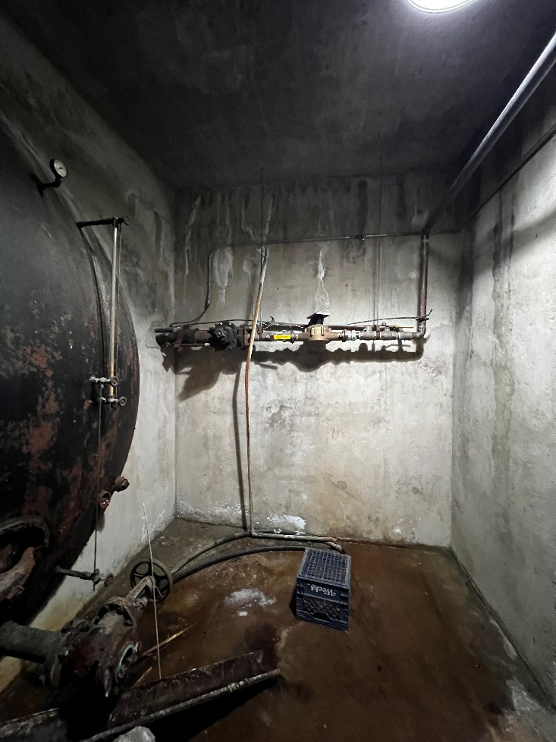
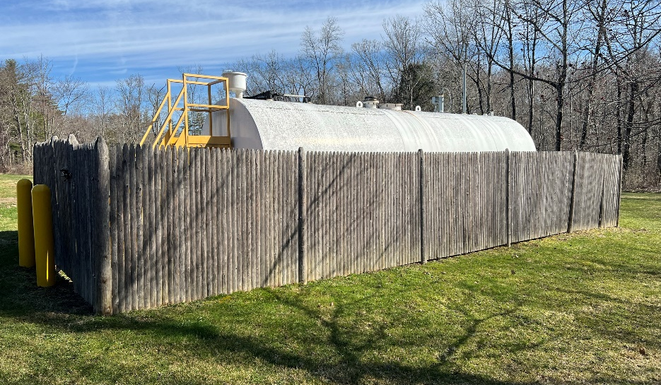
Utilities:
The end of the original water tank is visible from inside the Water Service Room.
The building was later connected to City water, so the water tank is no longer in use.
Sewer connection replaced existing septic.
An oil tank is located to the East of the building.
CONDITIONS ASSESSMENT - BANTAM ANNEX

Slide 16
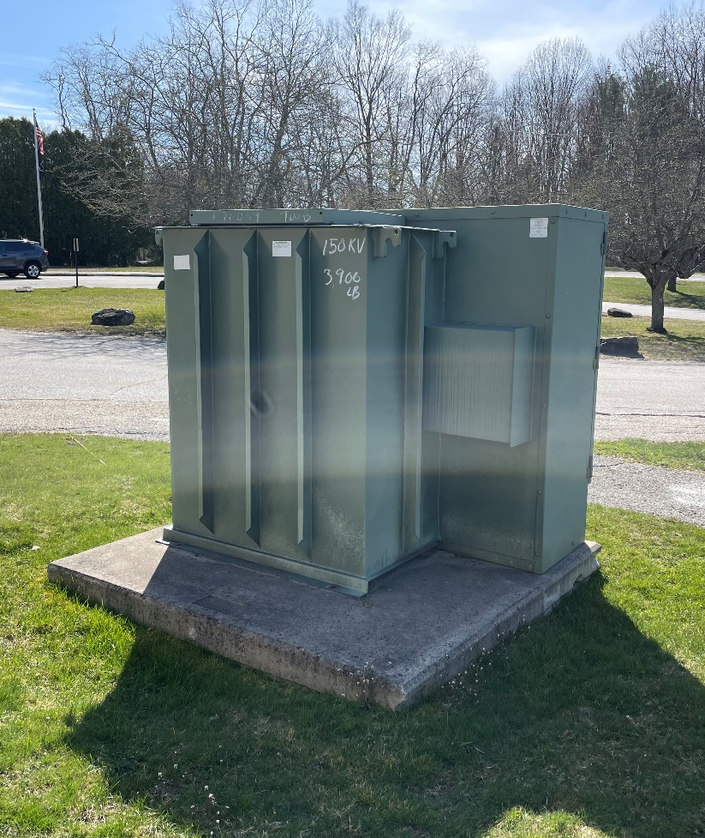
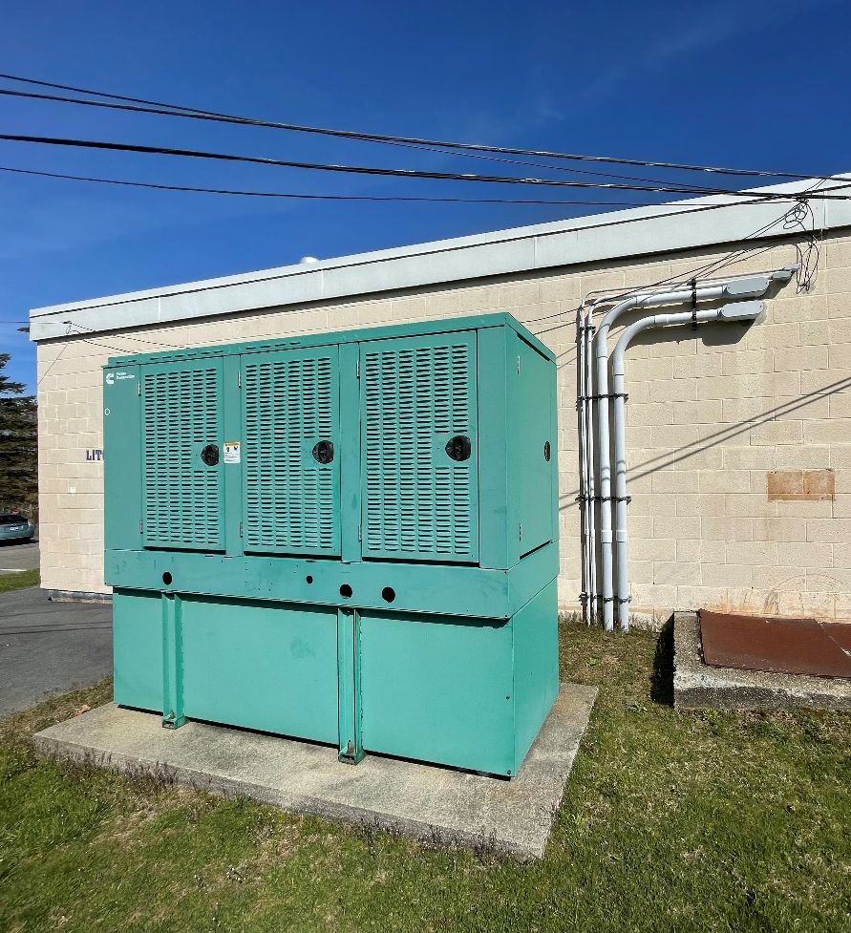
Utilities:
A transformer and generator are located on separate pads South of the Gym wing.
CONDITIONS ASSESSMENT - BANTAM ANNEX

Slide 17
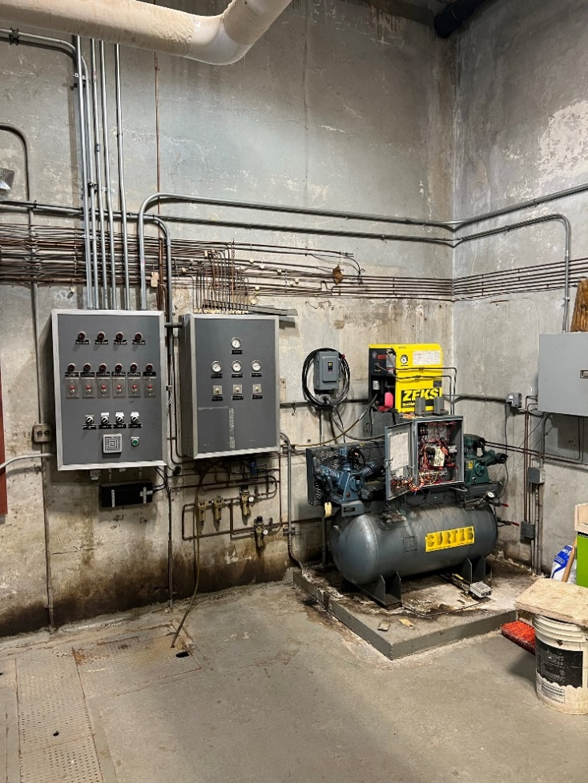
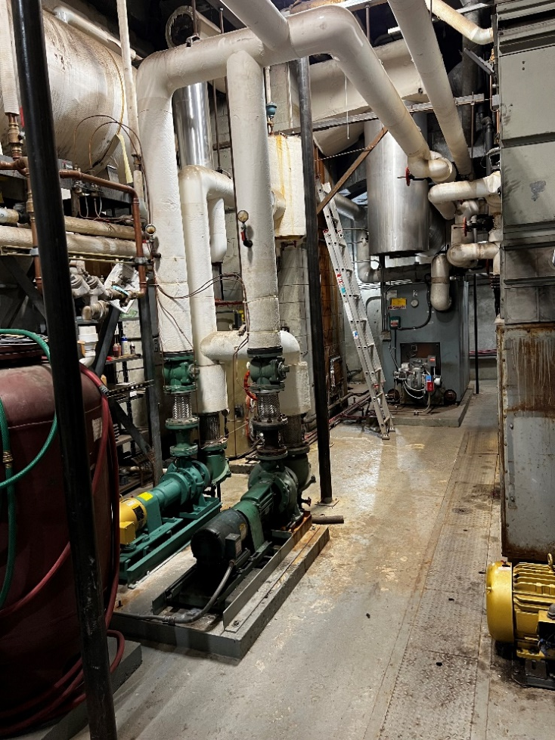
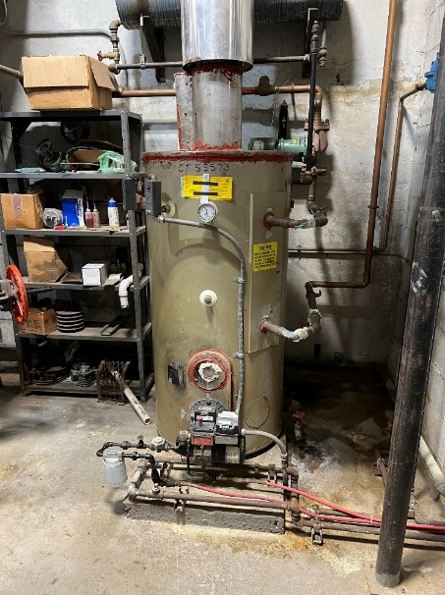
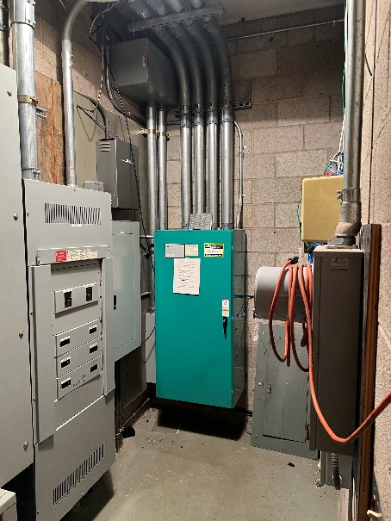
M/E/P:
Oil boiler, pumps, and air-handling units (AHU’s) with pneumatic controls.
Mechanical systems are generally beyond their useful life and are inefficient.
CONDITIONS ASSESSMENT - BANTAM ANNEX

Slide 18
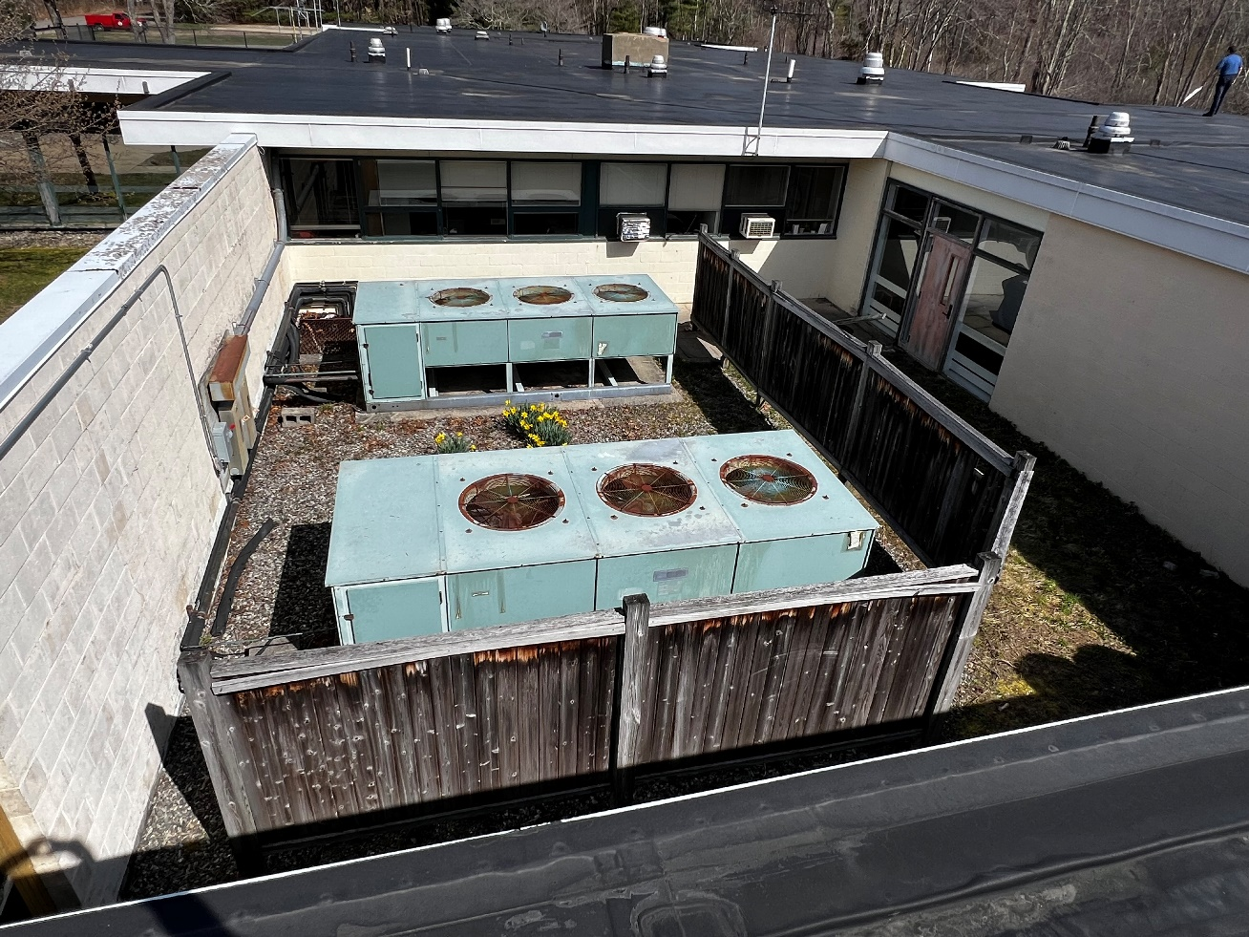
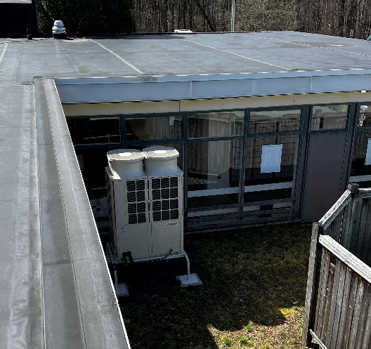
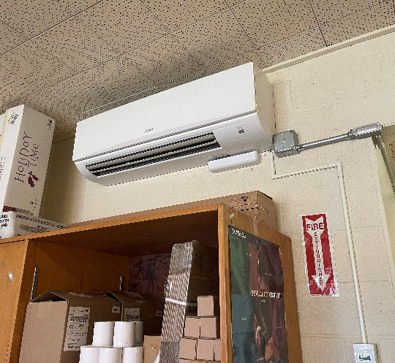
M/E/P:
The large AHU’s located in the courtyard which were used for A/C & dehumidification are no longer in use.
A condensing unit has been installed in the courtyard to serve the mini-split system in the Post Office.
BANTAM ANNEX - COURTYARD

Slide 19
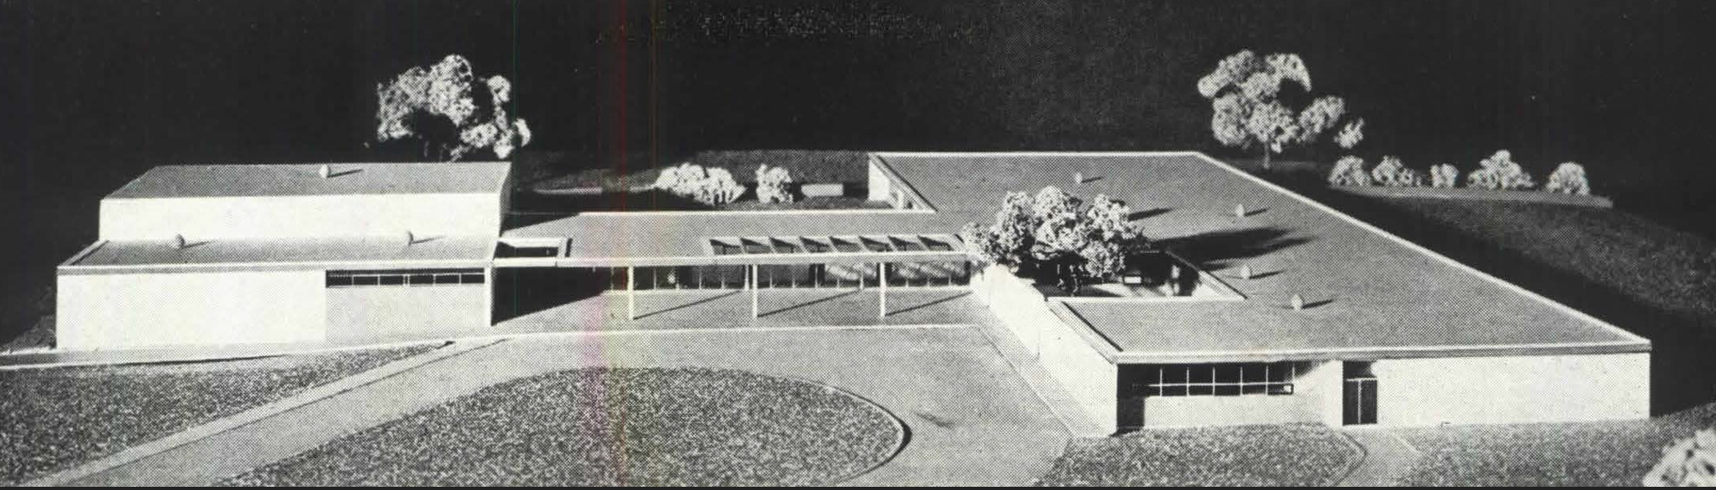
PROGRAMMING and PLANNING

Slide 20
Departments__________________________
Boards and Commissions & Stakeholders_________
Animal Control
Assessor
Building Department
Education
Emergency Management
Finance Department
Fire Marshal
First Selectman
Land Use
Parks and Recreation
Police Department
Probate Court
Public Works
Registrar of Voters
Sewer Department
Social Services
Tax Collector
Town Clerk
Tree Warden
Recycling Center
Post Office
Sustainable Litchfield
Smart Task Force
Design Review Committee
Housing Authority
Housing Plan Steering Committee
Town Facilities Study Committee
Traffic Safety Community Action Group
Option 5: Recommendation Legend
Located at Town Hall
Located at town Bantam Annex
TOWN DEPARTMENTS & OFFICES

Slide 21
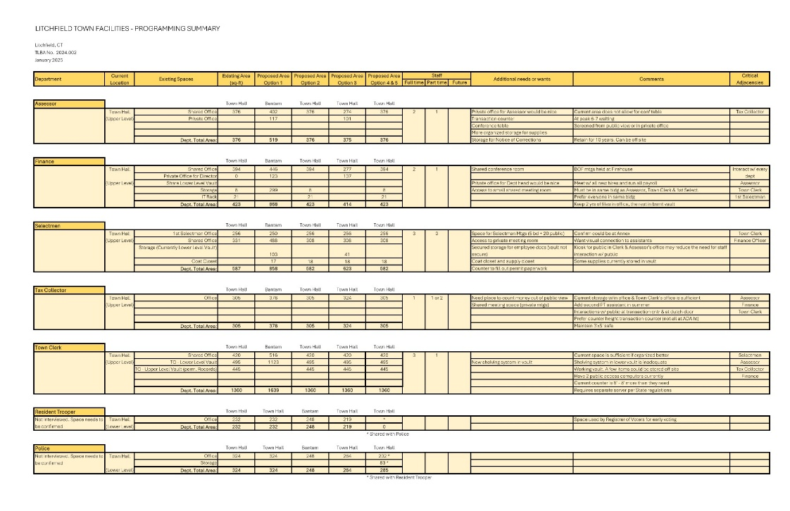
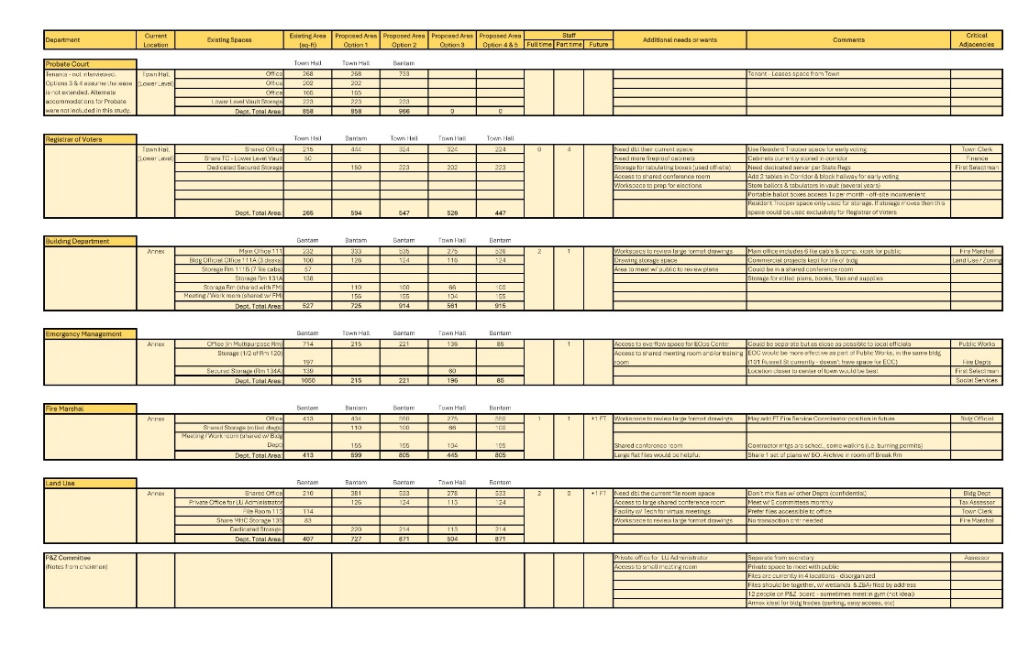
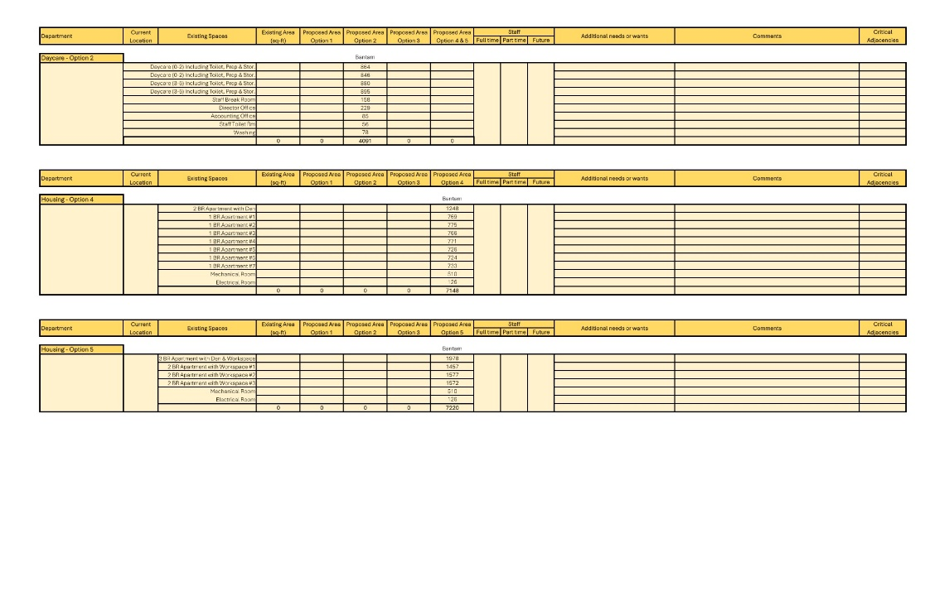
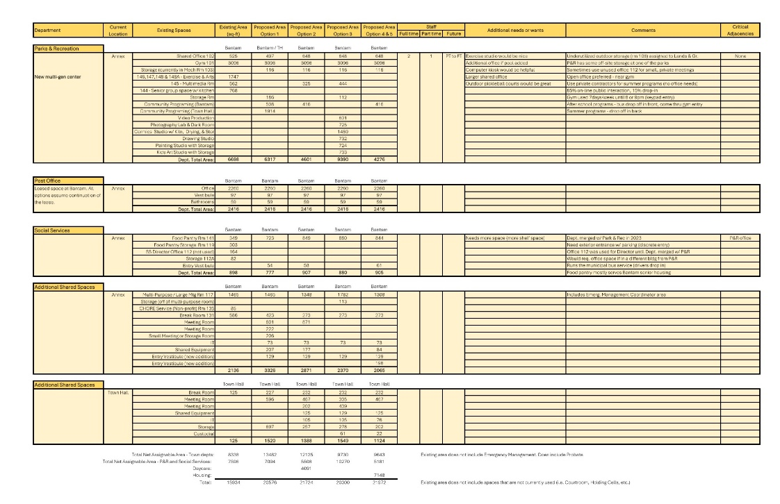
PROGRAMMING WORKSHEETS

Slide 22
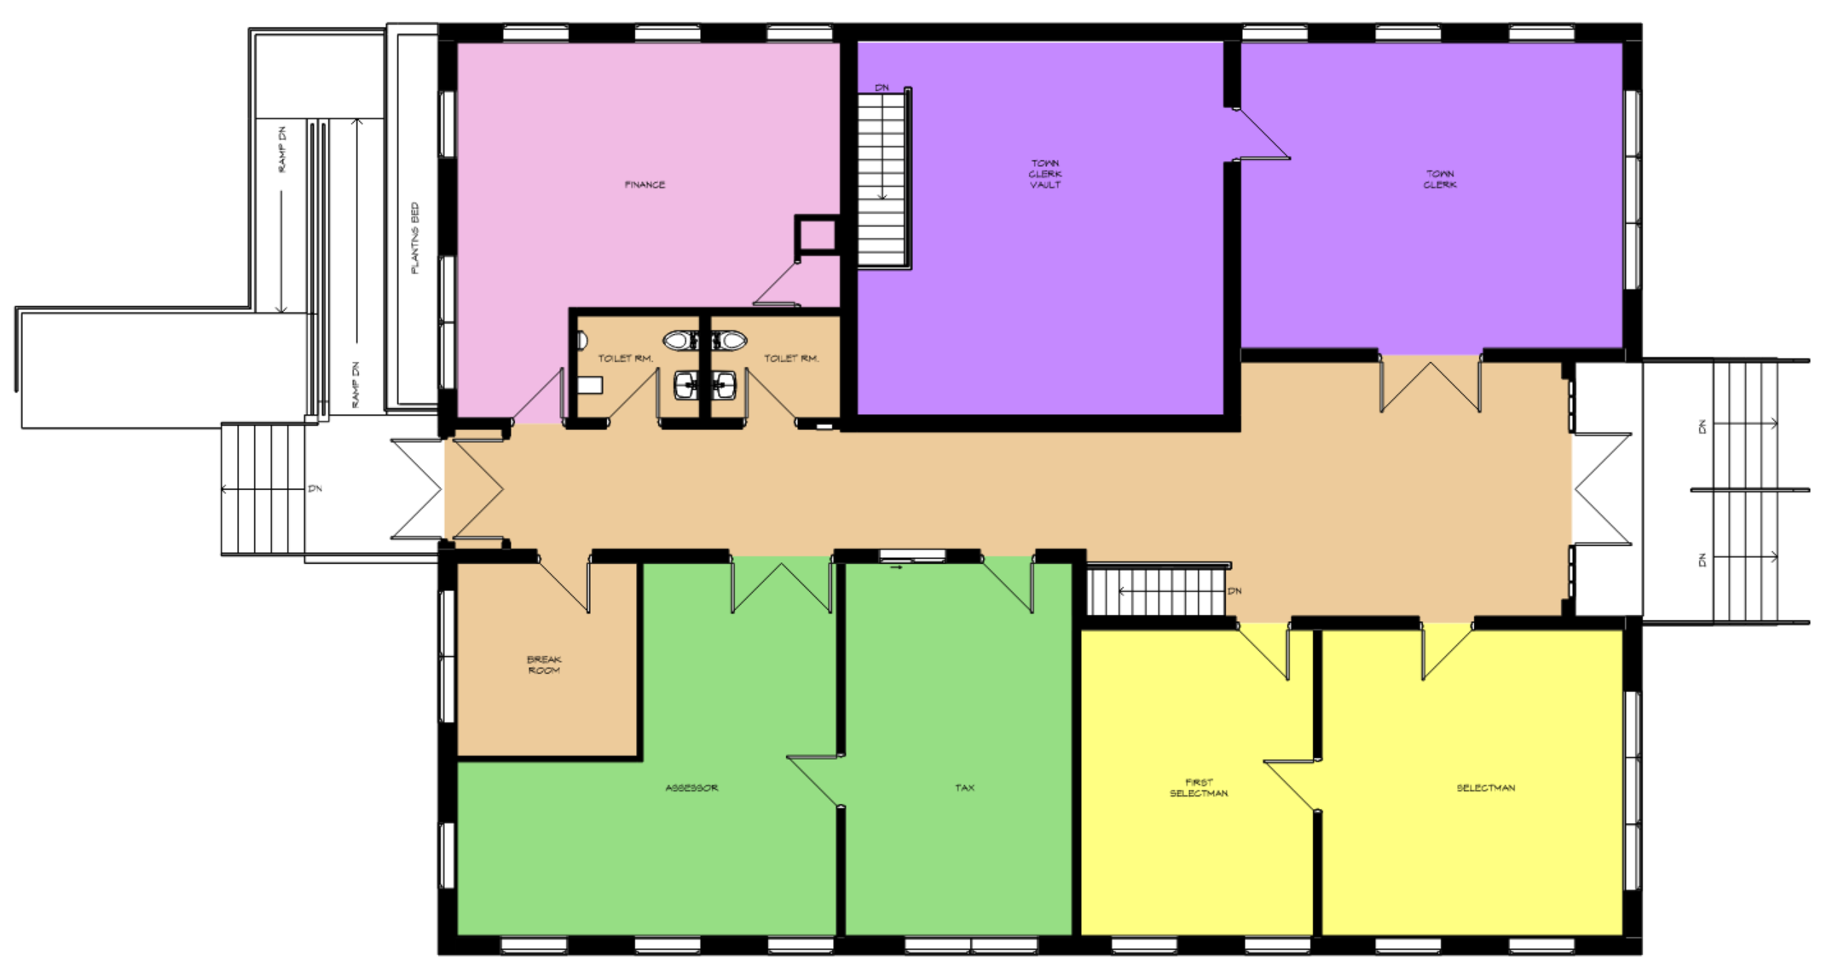
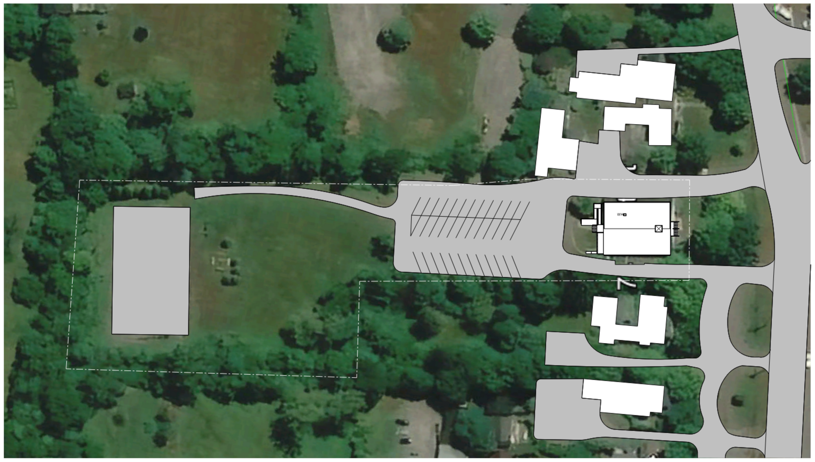
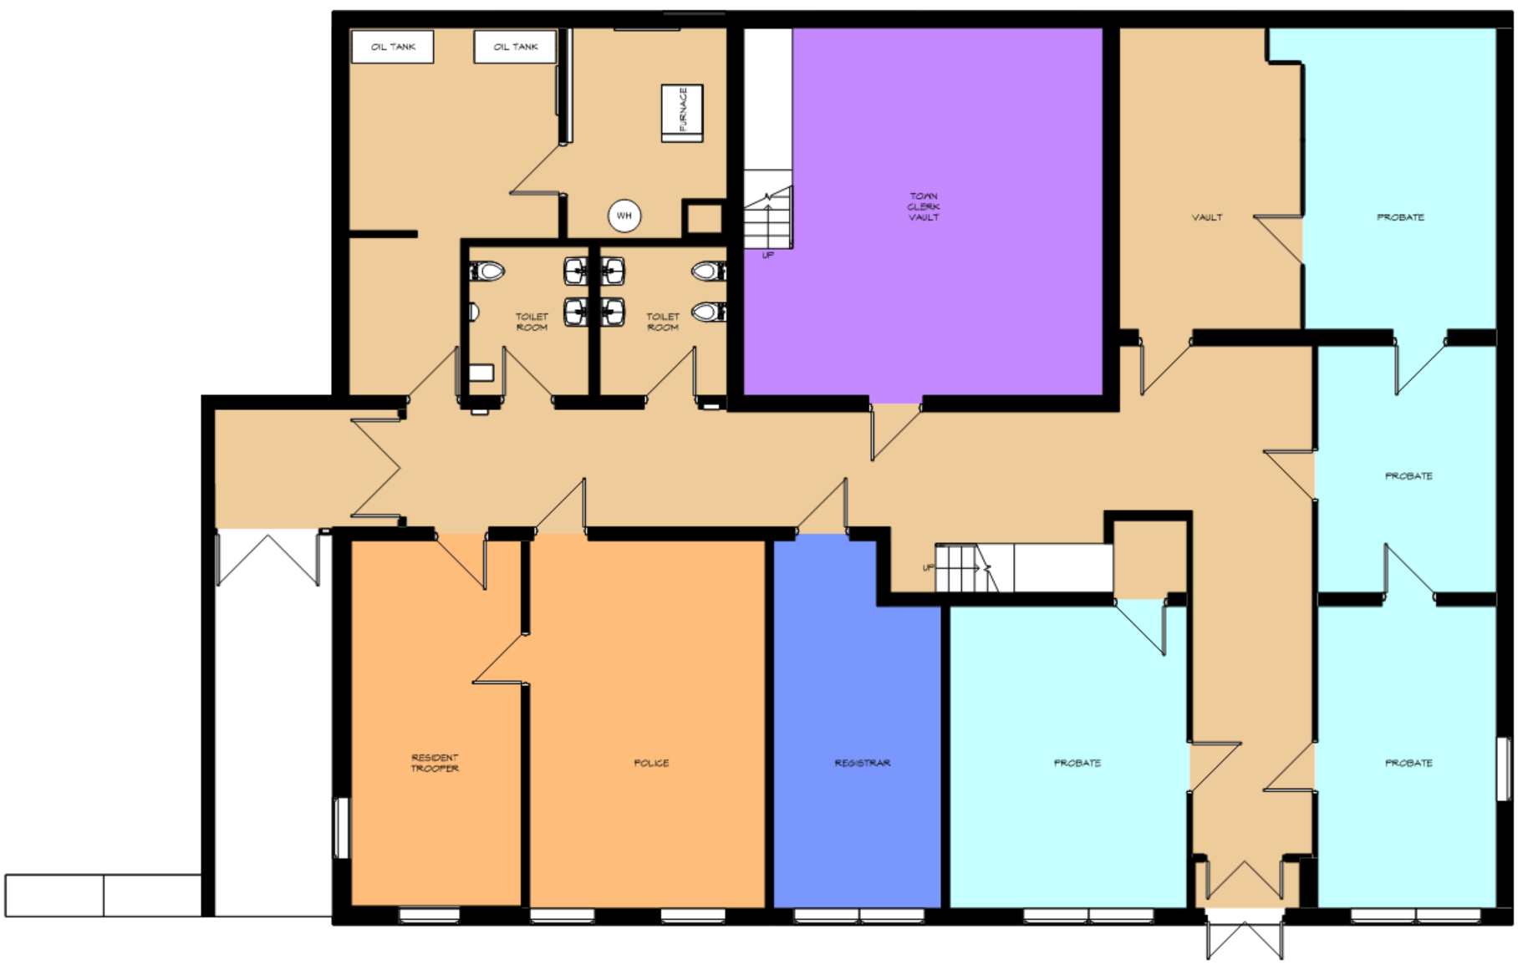
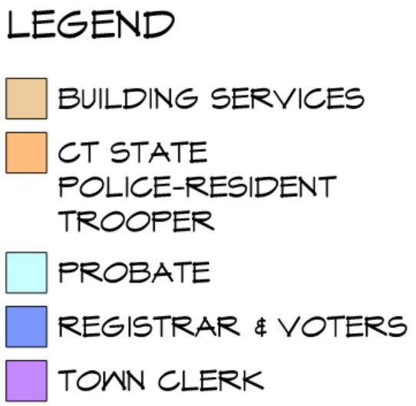


UPPER LEVEL
LOWER LEVEL
TOWN HALL – EXISTING PLANS

Slide 23
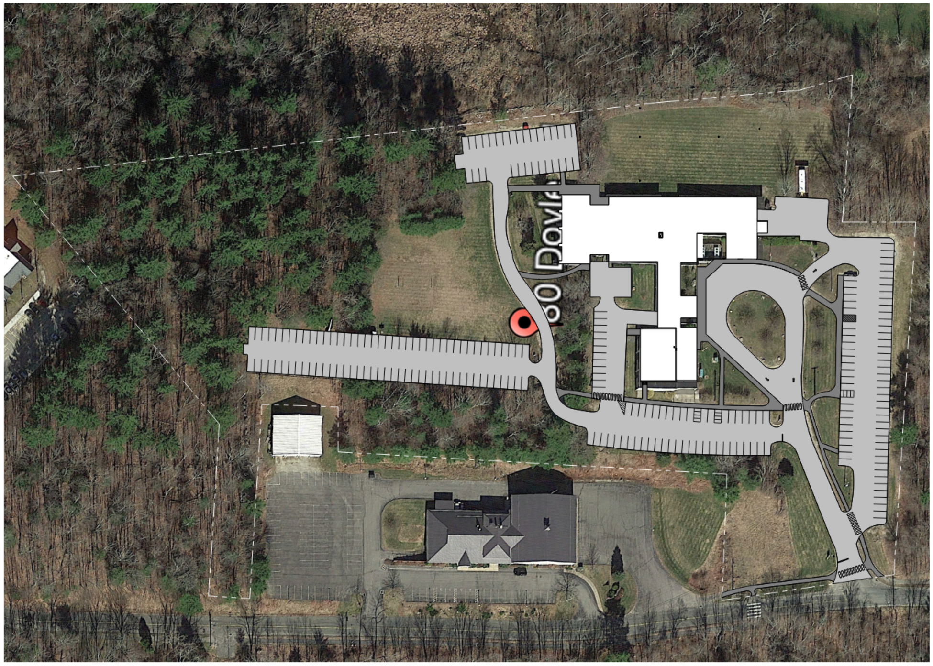
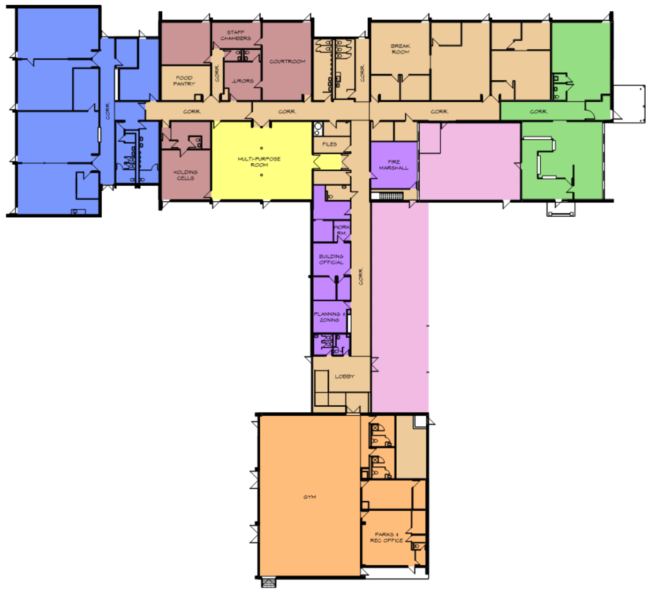


BANTAM SCHOOL – EXISTING PLANS

Slide 24
BANTAM SCHOOL – DEMOLISH AND RELOCATE DEPARTMENTS

Slide 25


OPTION 1: TOWN HALL AT BANTAM and MULTIPURPOSE SPACE IN LITCHFIELD CENTER

Slide 26


OPTION 2: MAINTAIN TOWN HALL FUNCTIONS AT CURRENT LOCATIONS WITH DAYCARE AT BANTAM

Slide 27

OPTION 3: TOWN HALL WITH ADDITION WITH COMMUNITY PROGRAMMING AND ARTS CENTER AT BANTAM

Slide 28

OPTION 4: MAINTAIN TOWN HALL FUNCTIONS AT CURRENT LOCATIONS WITH APARTMENTS AT BANTAM

Slide 29

OPTION 5: MAINTAIN TOWN HALL FUNCTIONS AT CURRENT LOCATIONS WITH 4 APARTMENTS AT BANTAM

Slide 30

OPTION 2A: MAINTAIN TOWN HALL FUNCTIONS AT CURRENT LOCATIONS and DEMOLISH 1960s ADDITION AT BANTAM

Slide 31

Masonry Wall R-Values
Existing single wythe masonry wall: R2
New Masonry wall with insulated cavity: R29.5
Glazing R-Values
Existing single pane glazing: R<1.0
New ¾” insulated glazing: R3.5
BUILDING UPGRADES – BUILDING ENVELOPE

Slide 32


DEEP West District HQ
BUILDING UPGRADES – HVAC (ELECTRIFICATION) CASE STUDY

Slide 33
HISTORIC RESTORATION – TRELLIS AT BANTAM ANNEX

Slide 34


HISTORIC RESTORATION – BANTAM ANNEX COURTYARD

Slide 35

HISTORIC RESTORATION – CORRIDOR

Slide 36


HISTORIC RESTORATION – CLASSROOM

Slide 37

HISTORIC RESTORATION – MULTIPURPOSE ROOM

Slide 38
COSTS and PHASING

Slide 39


Town Hall: $5.8 M (No Work)
Bantam Full Renovation: $32.8 M
ESTIMATE OF PROBABLE COSTS – OPTION 5: RECOMMENDATION

Slide 40


Phasing approach breaks Project into more manageable Projects to be funded over time. Each phase carries its proportion of the following:
Hazardous Materials abatement
Envelope and Finishes Upgrades
Building Electrification and PV
HVAC and Mechanical Systems with Potential for Geothermal Systems
DIAGRAMMATIC PHASING PLAN AND COST ESTIMATE – OPTION 5

Slide 41

Phase 1: Roof $2.4M
Phase 2: West Wing, Food Pantry: $7.2M
DIAGRAMMATIC PHASING PLAN AND COST ESTIMATE – OPTION 5

Slide 42

Phase 3: East Wing- Apartments $13.5 M
Phase 4: East Wing Offices & Courtyard $3.4 M
ESTIMATE OF PROBABLE COSTS – OPTION 5 PHASED APPROACH, CONTINUED

Slide 43

Phase 5 & 5A: Connector, Vestibule and Entry Court
$10M
Phase 6: Post Office $1 M
ESTIMATE OF PROBABLE COSTS – OPTION 5 PHASED APPROACH, CONTINUED

Slide 44
OPTION 2A
OPTION 5
BANTAM OPTIONS 2A AND 5

Slide 45
Program Description:
Option 2A:
  Maintain most town hall functions in their current locations.
  Move Resident State Trooper, Police and Probate Court to Bantam Annex.
  Demolish the 1960s addition at Bantam.
Option 5:
  Maintain Town Hall functions in their current locations.
  Include 4 apartments with live/work space, compliant with the recent zoning changes.
  Probate Court is not included in this option.
Full Build Out Option 2A: $23M
(Demo 1960s Wing in Phase 1)
Phased Build Out of Option 2A: $26M (assuming 1-year intervals)
Full Build Out of Option 5: $32.8M
(with 4 Apartments)
Phased Build Out of Option 5: $37M
COST COMPARISON OF OPTIONS 2A AND 5

Slide 46


ARTS-BASED LIVE / WORK SPACE
TOWN HALL CAMPUS
Arts-based Apartments
Arts Programming
Rentals require involvement in community-based arts programs.
  Classes
  Open Studios
  Gallery
  Business Development Services
Expanded P&R Program
Separate buildings to provide flexibility
PROGRAM OPTION E: Presented at May 22, 2024 Public Meeting #2

Slide 47

Q & A and DISCUSSION
“What a wonderful site! How do we avoid spoiling it?”
Marcel Breuer
QUESTIONS & ANSWERS
THANK YOU
www.tlbarchitecture.com

